Slide 1
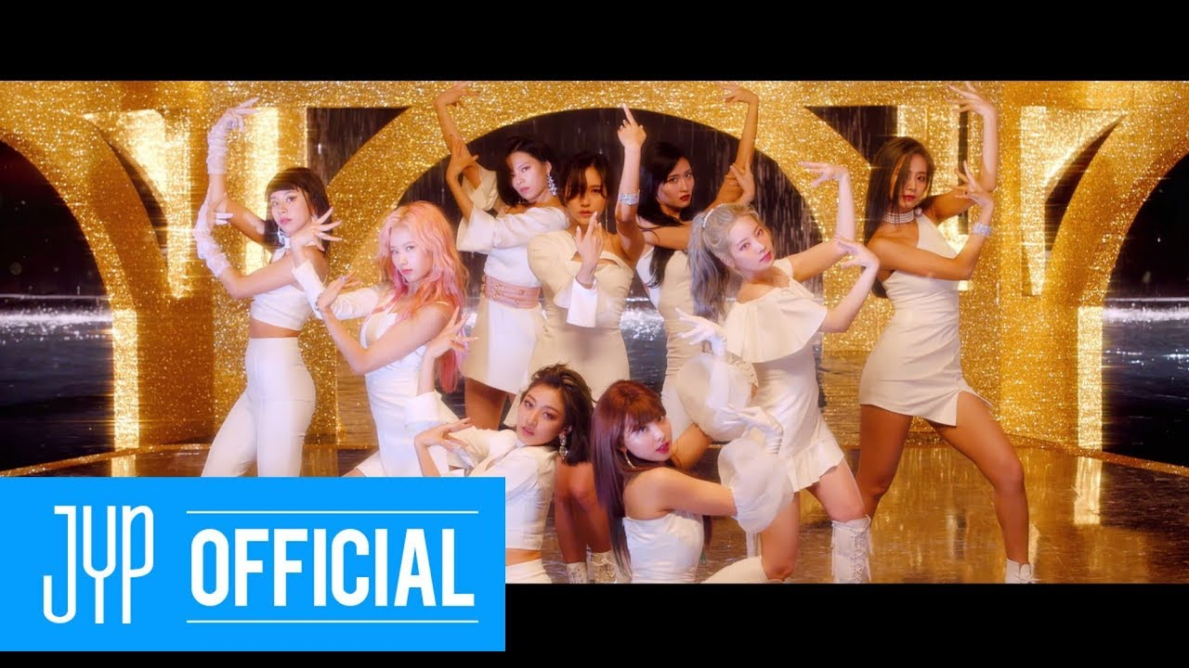
The meaning of Feel Special

Slide 2
First impression
Gorgeous
Cool
Serious facial expression
However, after looking at it with captions and researching the history of the Twice group and the background of the song's creation, I could learn many things.

Slide 3
About Twice
Twice was born from an audition program that broadcasted in South Korea in 2015.
They consist of Koreans, Japanese, and Taiwanese.
The name of the group, “Twice” means to give the gift of excitement once with good music and twice with great performances
Most of their songs are mainly bright and pop.

Slide 4
Background
However, this is not a cheerful song.
This song was released in 2019 as the 8th album.
In fact, during this period, one member was suspended due to a panic disorder, and some members were bashed.
It was composed by their producer, who heard how they overcame tough moments during their four years as idols.

Slide 5
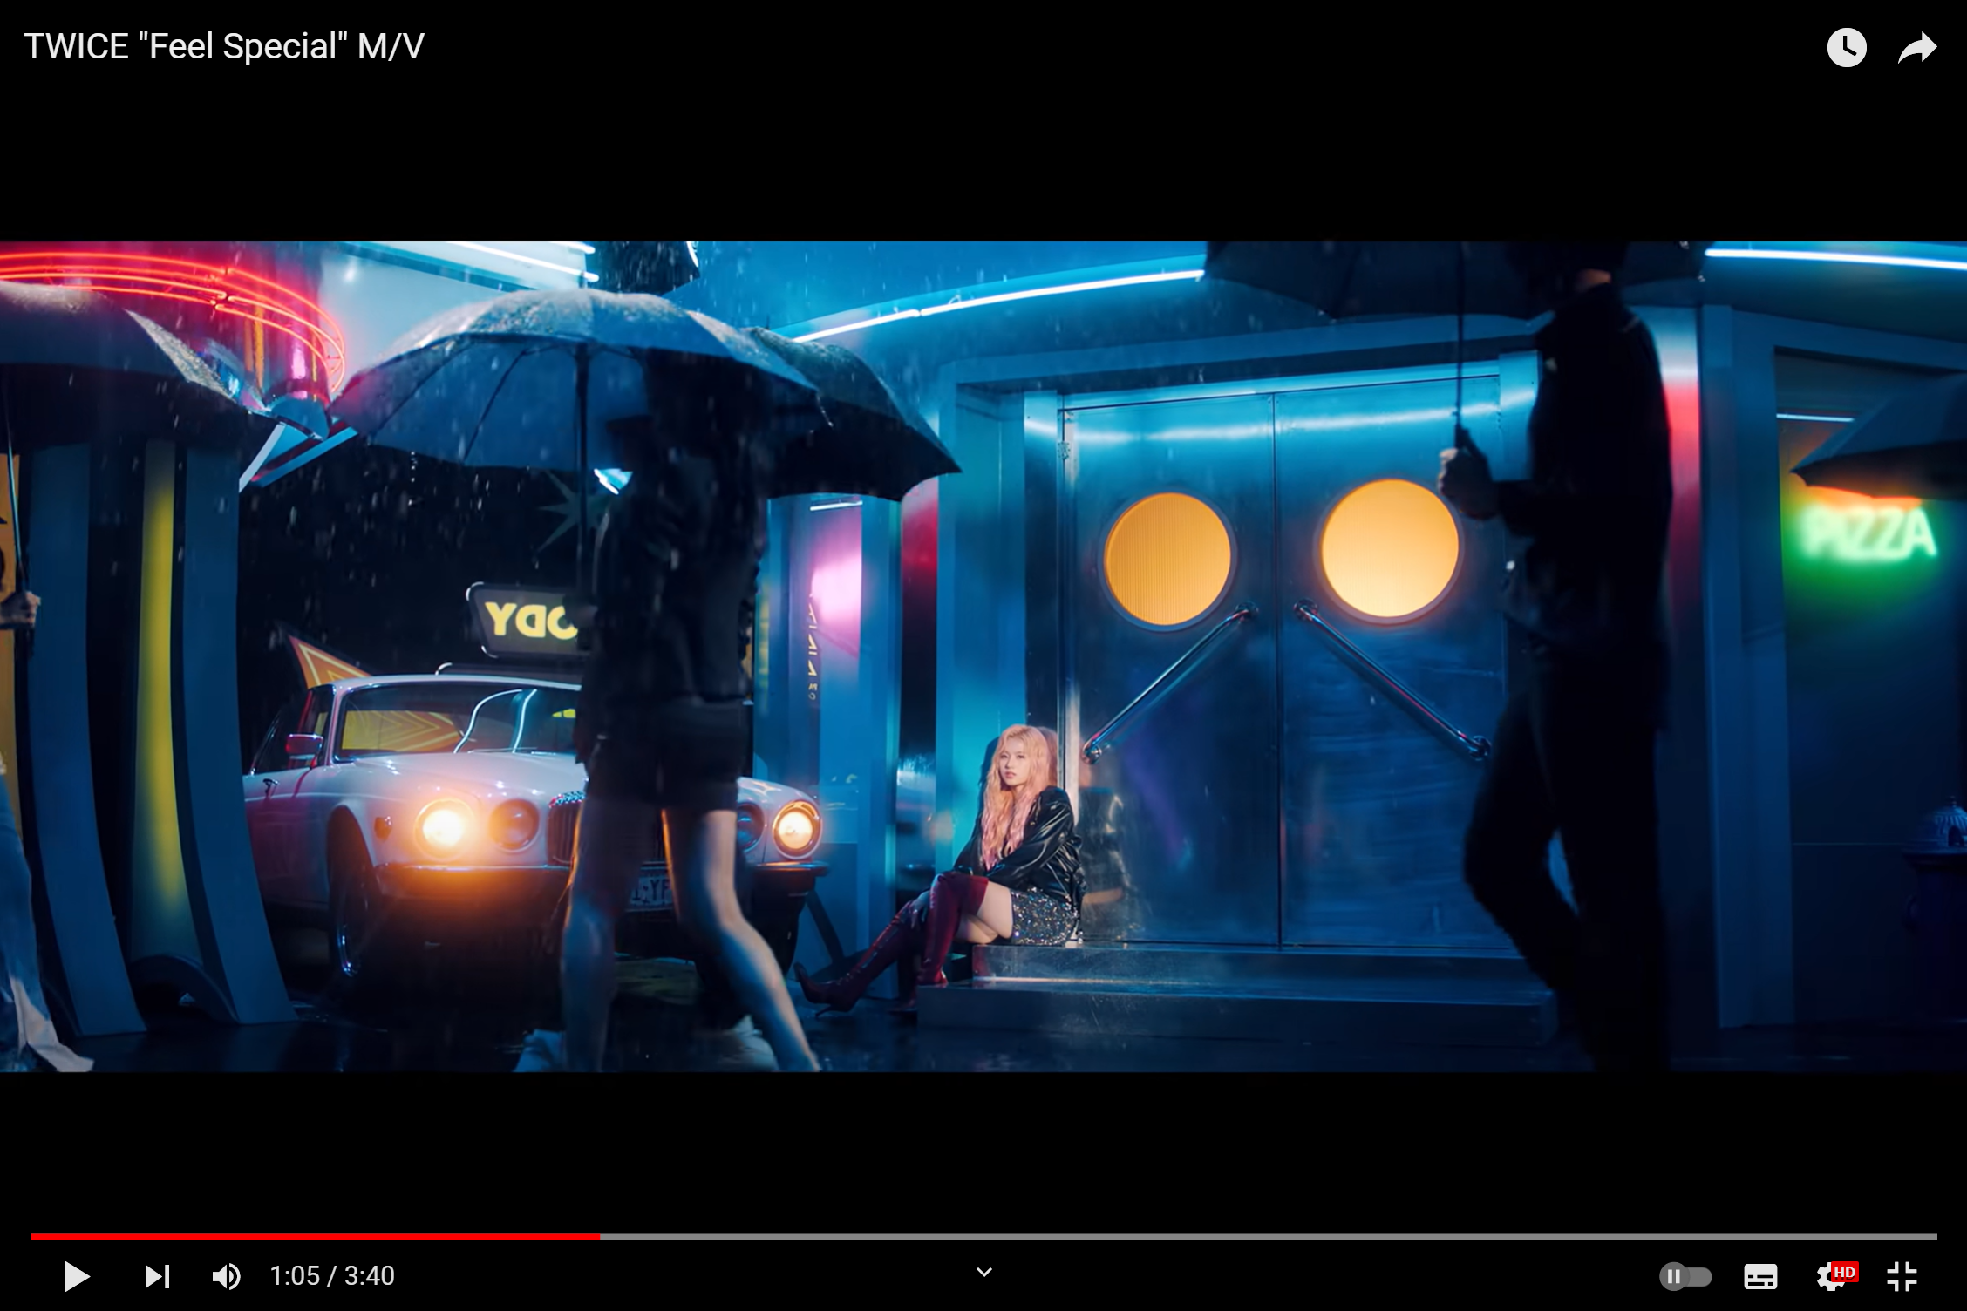
・In this scene,
it is raining.
I think this rain means bashing against them and difficulties such as panic disorders such as a certain member has
.

Slide 6
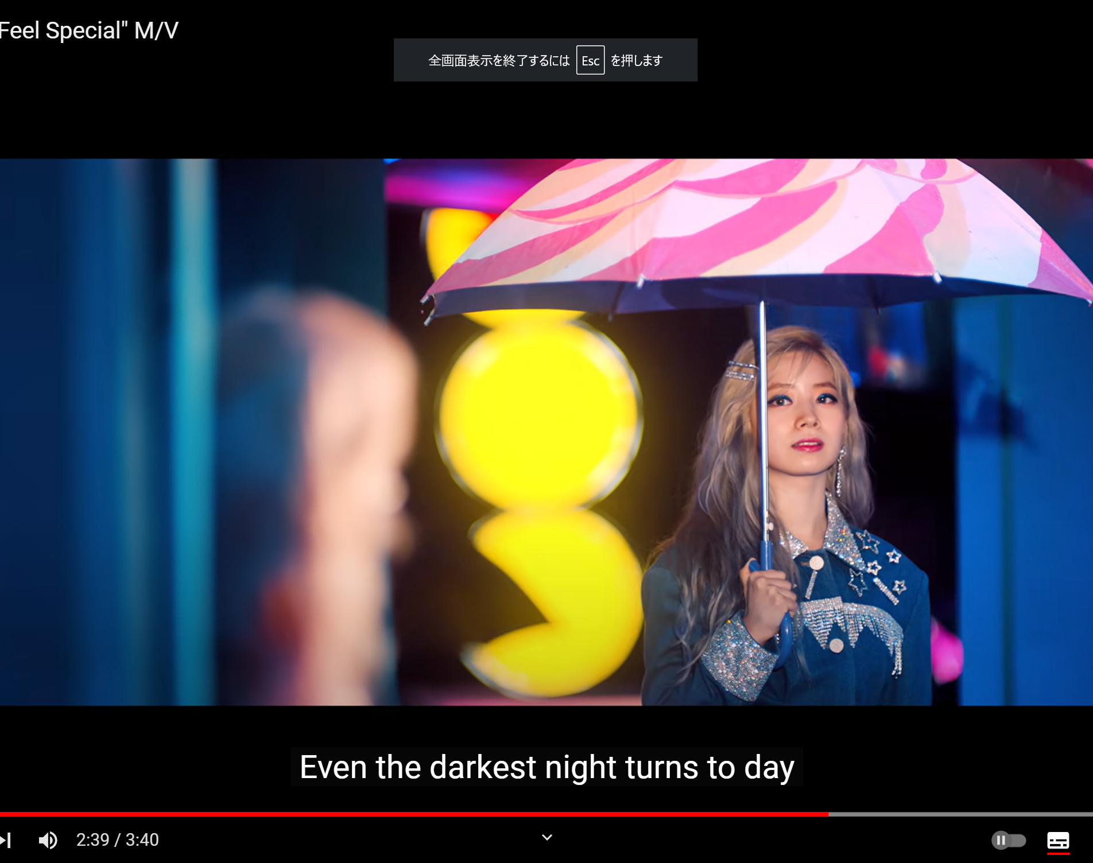
There was the scene where a fellow with an umbrella comes looking for a pink-haired woman who is drenched in the rain.

Slide 7
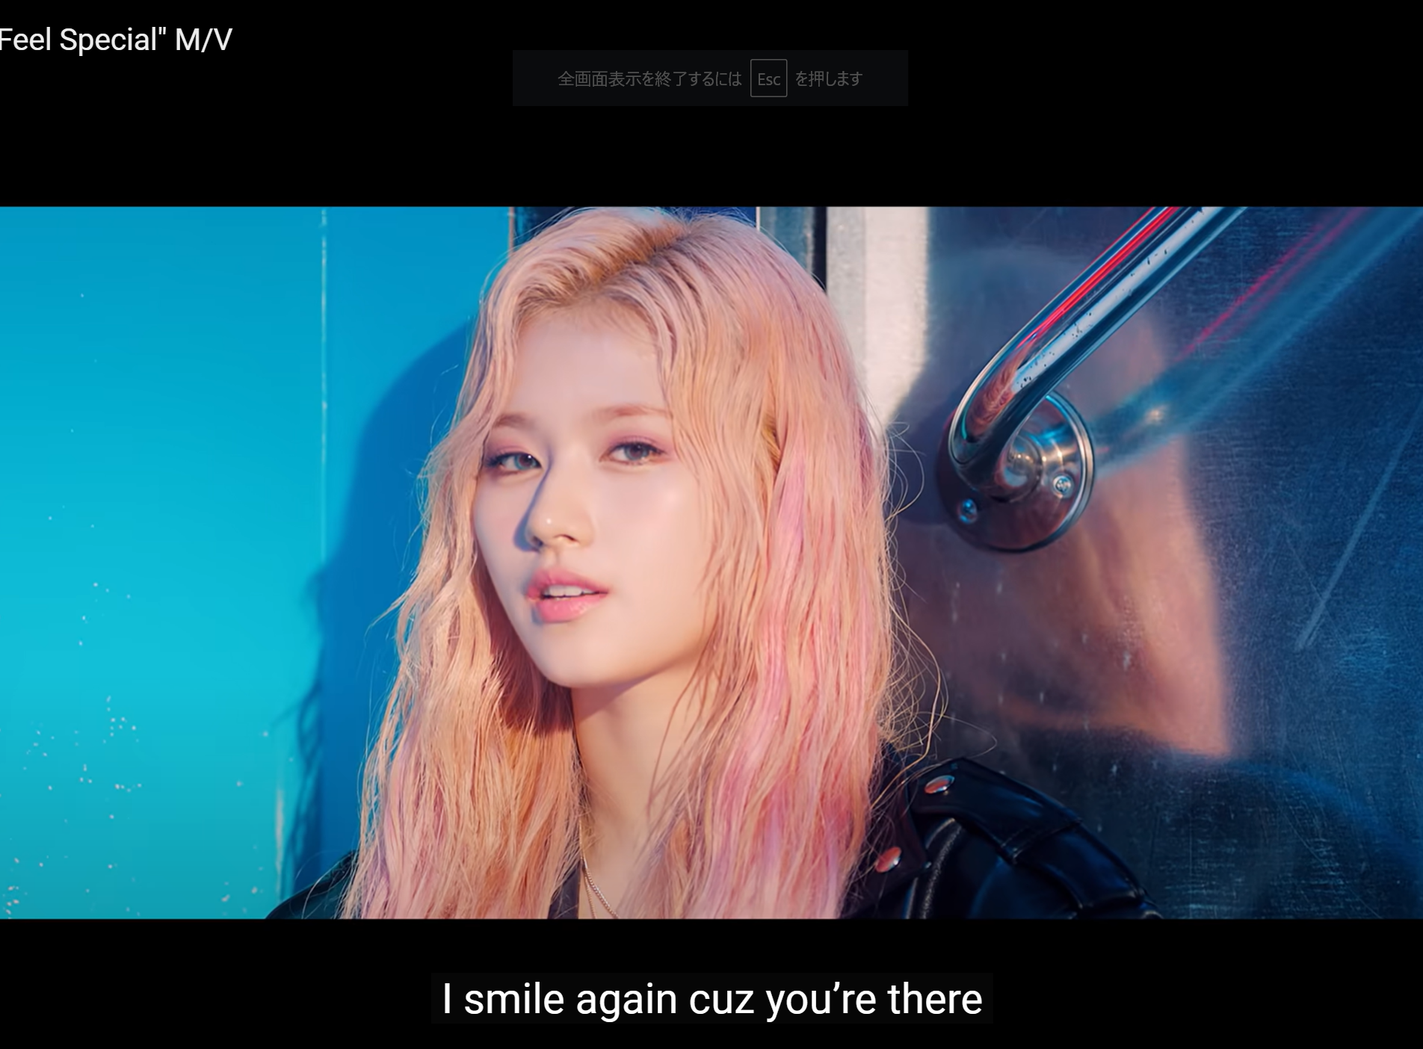
She says “I simile again cuz you’re there”

Slide 8
Conclusion
I think they wanted to convey in this video that even these usually cheerful girls sometimes encounter difficulties, but with the help of their friends around them, they are able to smile again.
I also felt that the gorgeous set represents the strength of the girls' hearts and the bond between them.

